Slide 1
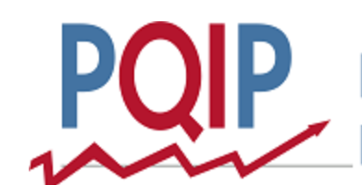
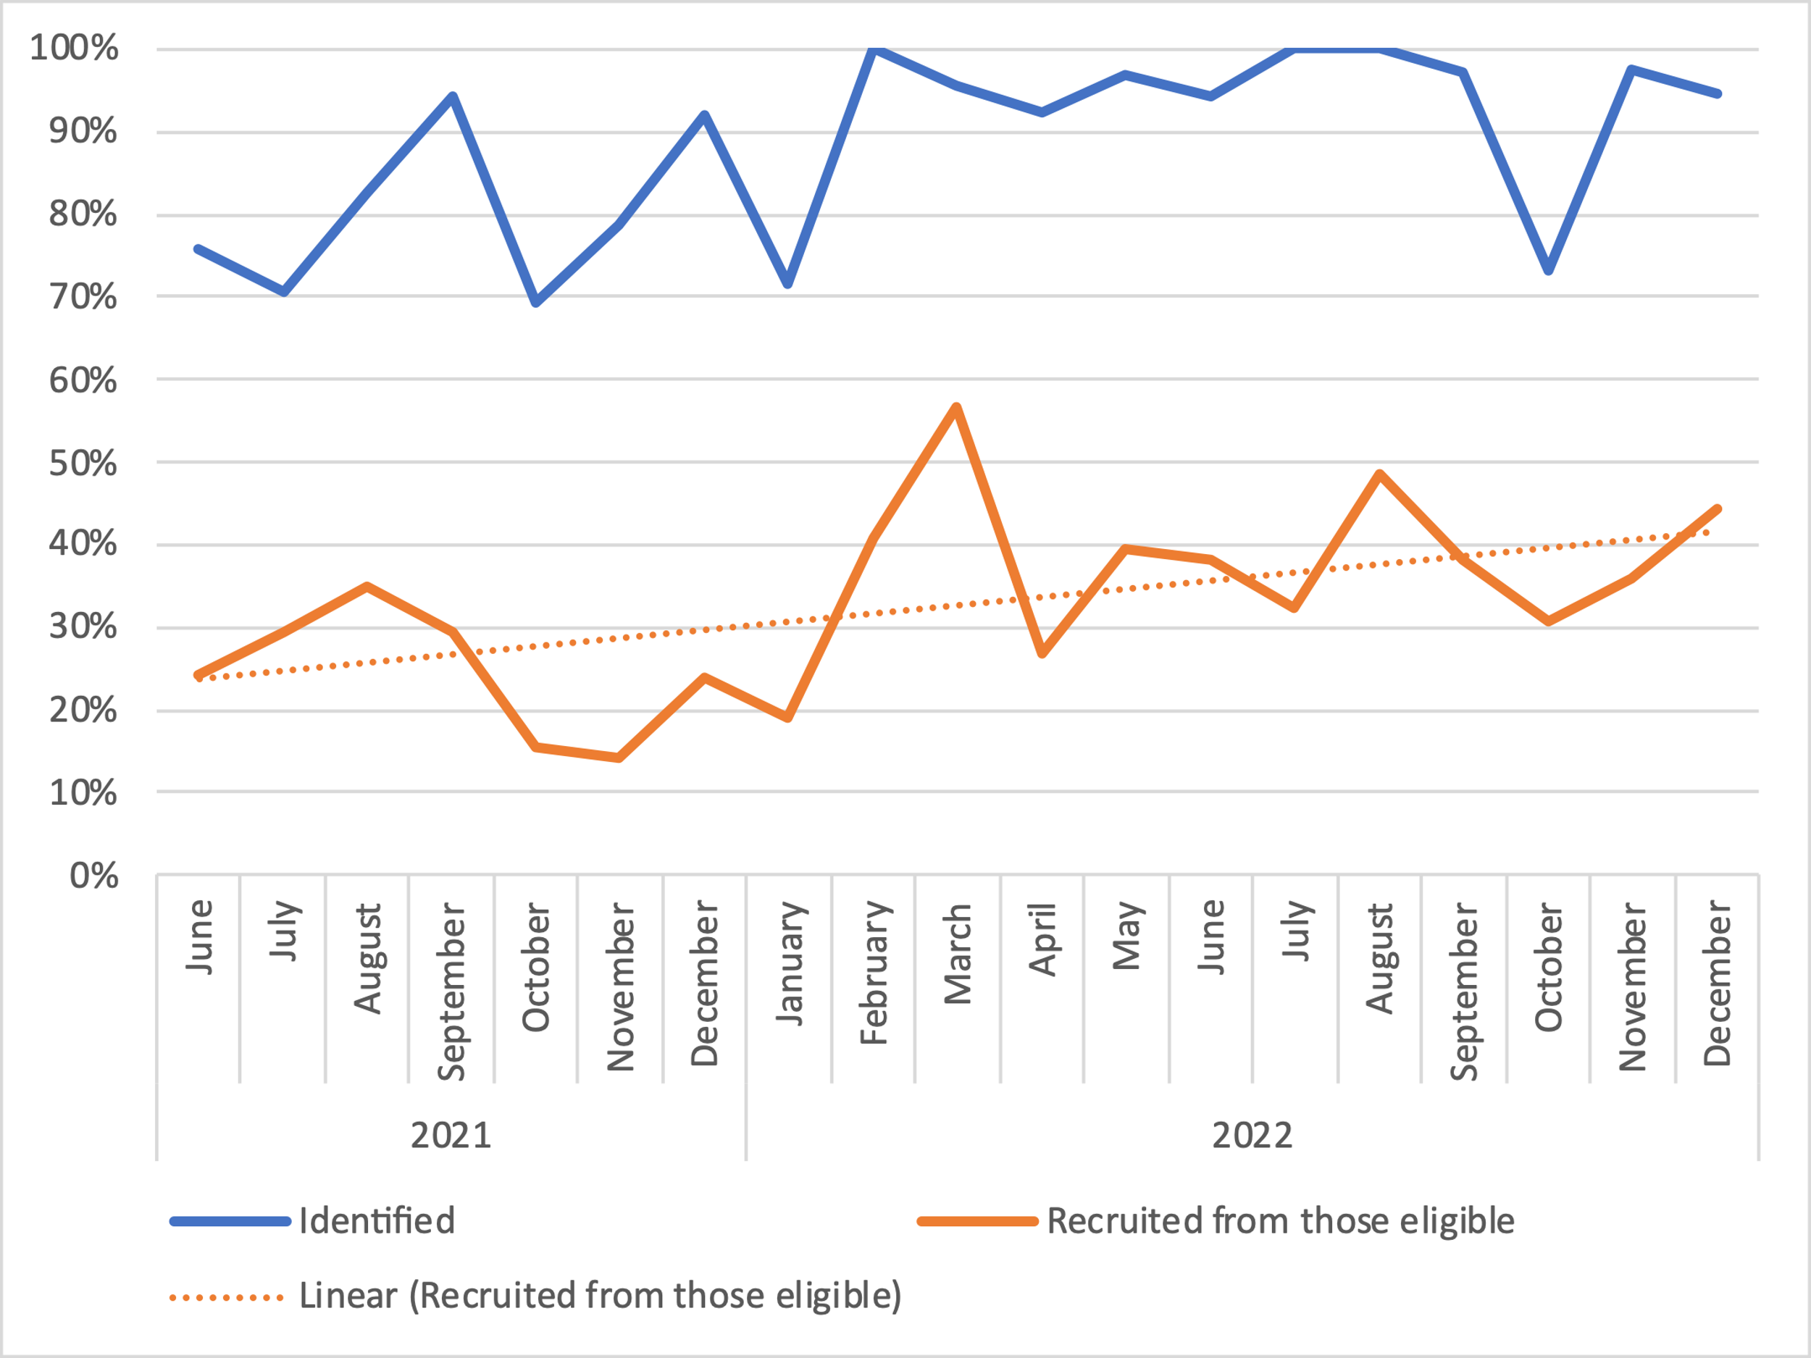
PQIP: Increasing recruitment through improved patient screening processes
Nicholas Brassington, Amy Fox, James Wheeler, Johanna Paterson
Introduction
Maximising recruitment was one of the Top 5 Priorities 2021/22¹
Not all patients undergoing lower GI procedures at South Tees were being screened
The aim of this project was to evaluate whether a new system introduced to improve screening and recruitment rates had been effective, before rolling out PQIP to additional specialties
Methods
A list of all colorectal operations conducted each month was obtained from the theatre administrator
This was cross-matched with the PQIP procedures list to identify all patients who would have been eligible
Comparison was made with the recruitment log to establish how many eligible patients had not been screened
A new system was introduced in January 2022 which allowed the research team to access theatre lists with patient and operation details as soon as they were available
From April 2022 urology patients were also recruited to PQIP
Data was collected for both specialties going forward
Results
Data was collected for colorectal patients for 19 months – from June 2021 to December 2022
Data for urology patients was collected from April to December 2022
Figure 1 shows the percentage of eligible patients identified for screening
Identification rates were highly variable until February 2022, after which it remained above 90% for all but one month
Although the percentage of eligible patients recruited remained variable, there was an upward trend over this time
The upward trend in recruitment was maintained after inclusion of a second specialty
Conclusion
The new screening approach taken at South Tees has improved the percentage of eligible patients identified and subsequently recruited
The effectiveness of this system replies on an MDT approach with close working between surgical and research teams
This project demonstrates that high rates of identification can be maintained when widening participation in PQIP to additional specialties
Further improvements in recruitment rates may require additional strategies – additional data collected as part of this project suggest that the most common reason for screening but not subsequently recruiting to PQIP were inability to engage the patient in the research process
Acknowledgements
The authors wish to thank the research team at James Cook Hospital for their support in collection of the data for this project.
References
1. Edwards K-E et al. 2021. Report 3: August 2019-July 2021. Perioperative Quality Improvement Programme. NIAA Health Services Research Centre, London.
Figure 1. Percentage of eligible patients identified for screening and subsequently recruited. The dashed green line represents the introduction of the new system for identifying eligible patients.

